Slide 1
Tanker Deployment / How Does It Affect a Fire Department Rating
Randolph County
December 5, 2024

Slide 2
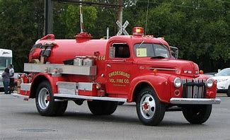
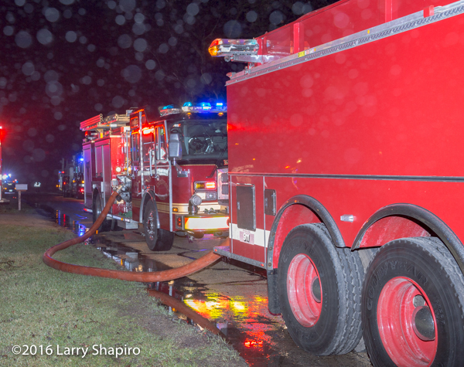
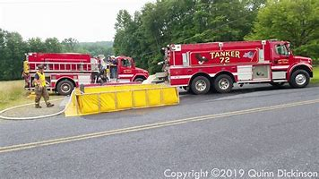
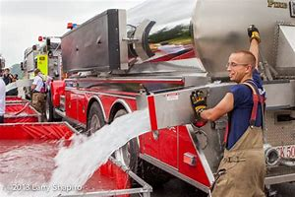
History of Hauled Water and ISO Ratings

Slide 3
History of Hauled Water and ISO Ratings
What has changed in the last 25 to 30 years concerning alternate water supply operations.
Size of tankers
Move from jet dump to gravity dump
The tanker more efficiently built for filling and dumping
More Automatic Aid
Fewer Firefighters

Slide 4
Purpose of this meeting
“To discuss the deployment of tankers to structure fires, with a primary focus on how it affects the fire department’s rating, and to review the criteria used to determine if the initial alarm dispatch includes an adequate number of tankers.”

Slide 5
Objectives
Consider the following:
Assess Current Tanker Deployment
Review Deployment Effectiveness
Making The Best Use of Available Resources
Share Best Practices
Develop a Continuous Improvement Plan

Slide 6
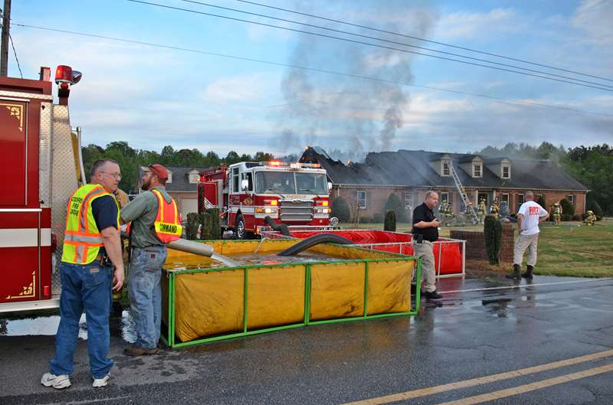
Questionnaire
Microsoft Forms (office.com)

Slide 7
How Does Water Hauls Operations Effect the Rating
Water Supply Credit

Slide 8
Rules for Calculating the Theoretical Flow For a Hauled Water Grade
ISO Hauled Water Rules
The fire department must start flowing 250 GPM
within 5 minutes of the first arriving engine and be
able to maintain that flow for 2 hours with out
running out of water
2. The department has 10 additional minutes to
increase the flow
3. If tankers cannot be on the scene within 15 minutes
of the first arriving engine it will not be credited in
the calculation

Slide 9
Simulated Flow Test
Equipment Dispatched on the First Alarm

Slide 10
Simulated Flow Test

Slide 11
Simulated Flow Test

Slide 12
Simulated Flow Test

Slide 13
Simulated Flow Test
1 Mile to Fill Point
Fill Time |  | Dump Time |  | Drive Time | Total Minutes
2.4 | + | 1 | + | 4.8 | 8.2
1.5 Mile to Fill Point
Fill Time |  | Dump Time |  | Drive Time | Total Minutes
2.4 | + | 1 | + | 6.4 | 9.8
Fill Time |  | Dump Time |  | Drive Time | Total Minutes
2.4 | + | 1 | + | 8.3 | 11.7
2 Miles to Fill Point
2.5 Miles to Fill Point
Fill Time |  | Dump Time |  | Drive Time | Total Minutes
2.4 | + | 1 | + | 10 | 13.4

Slide 14
East Side Hauled Water Review
East Side Hauled Water Results

Slide 15
Reducing the Number of Tankers Dispatched on First Alarm
Advantages
Disadvantages
Fewer trucks on the road and reduces the chance of an accident
Less wear and tear on the truck
Fewer trucks to manage on the scene
Less confusion
Fewer number of drivers needed
Not taking so much equipment out of the fire district
Does not take as long to dispatch a call.
Not having to deduct as many tanker drivers
More firefighters available to fight fire
Reduces radio traffic
Could lose a few points in the grading process
Reduce the number of firefighters on the scene

Slide 16
How to Move Forward
Consider the following:
Assess Current Tanker Deployment
  Review Current Dispatches: Analyze the tankers being dispatched throughout the county to identify potential improvements.
  Determine Optimal Tanker Numbers: Evaluate and establish the ideal number of tankers to dispatch for effective response.
  Evaluate Hydrant Coverage: Ensure tankers are not dispatched to areas adequately covered by hydrants.

Slide 17
How to Move Forward
Consider the following:
Reviewing Deployment Effectiveness
  Flow Rate: Are you consistently meeting the needed flow rate
  Timely Response: Are the appropriate trucks responding in a timely manor
  Automatic Aid Response: As an automatic aid department are you responding with what is being requested
  Operations: Are all departments responding familiar with all the different water supply operations your department might use.

Slide 18
How to Move Forward
Consider the following:
Making The Best Use of Available Resources
  Water Point Engine Assignment: Ensure an engine is assigned to the water point for establishing a fill site on every reported structure fire requiring static water points.
  Hydrant Utilization: Assess the necessity of putting an engine on a hydrant when using pressure hydrants to fill tankers.
  Water Supply Officer: Assign a water supply officer when utilizing alternate water supply operations to coordinate efforts effectively.

Slide 19
How to Move Forward
Consider the following:
Seek Out Best Practices
  Research: Review articles on the alternate water operation, talk to fire departments in other parts of the state or nation.
  Operational Planning: Include your automatic aid in planning water supply operation they might provide some new ideas.
  Training: Through training explore and test new ideas.
  TALK TO EACH OTHER

Slide 20
How to Move Forward
Consider the following:
Develop a Continuous Improvement Plan
  Establish Benchmarks: Set some benchmarks so everyone is working toward the same goal dealing with alternate water supply operations.
  Self Evaluations: Conduct an honest evaluation after each structure fire to see if you are meeting the benchmarks dealing with alternate water.

Slide 21
How to Move Forward
Challenges
  Resource Limitations: May not have the necessary time or personnel to develop and implement standard procedures effectively.
  Obtaining Technical Support: GIS technical support in the developing response plans would be very beneficial.
  Training and Expertise: Ensuring that all personnel are adequately trained and proficient in the procedures can be time-consuming and costly. Variations in experience and skill levels can also pose challenges.
  Consistency in Implementation: Maintaining consistency in the application of procedures across different incidents and departments can be challenging, especially under the pressure of emergency situations.
  Working as One: Different fire department working together on projects like this become difficult.

Slide 22
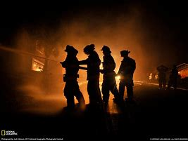
For all structure fires, automatic aid will be provided 100% of the time.

Slide 23

Questions

